Slide 1
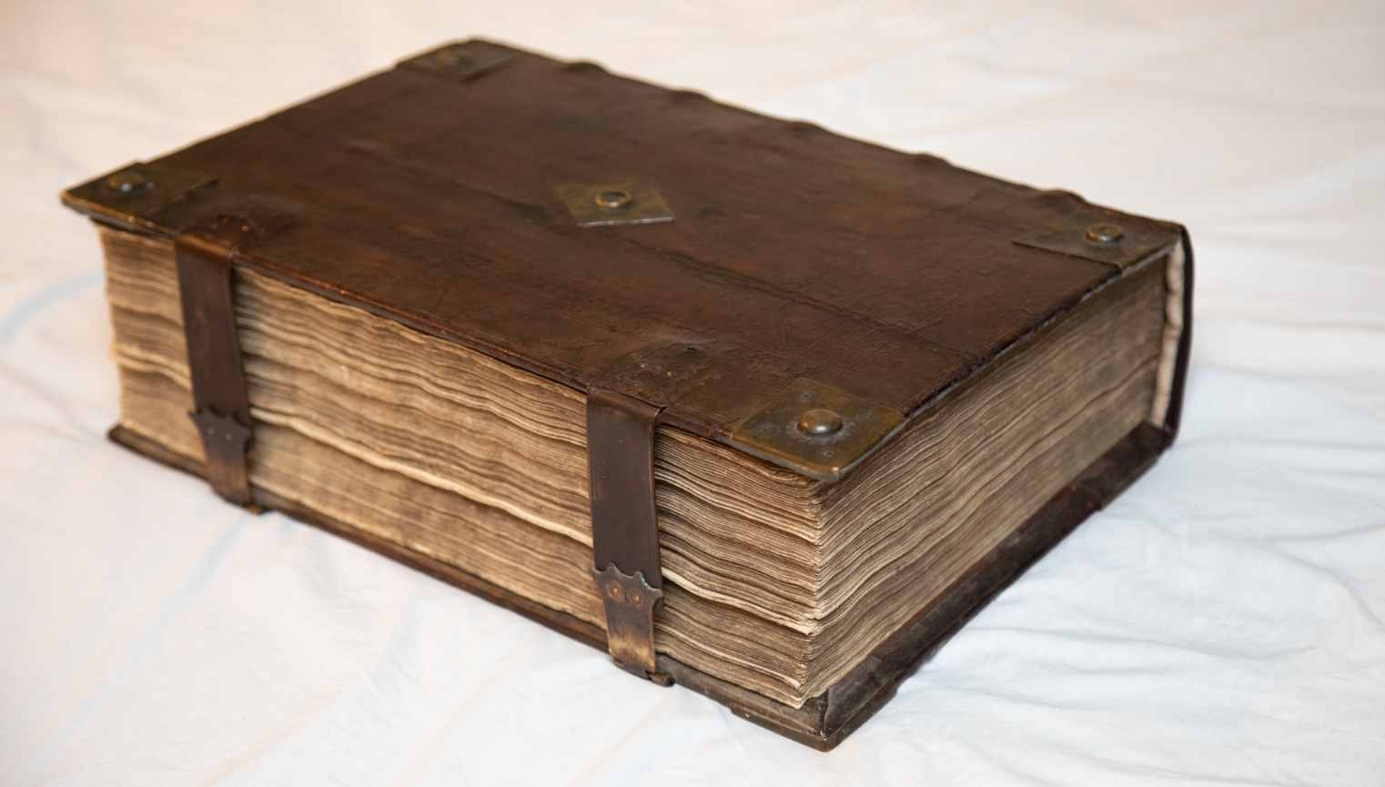
ThE World’s Greatest Book
Reflections… #6

Slide 2
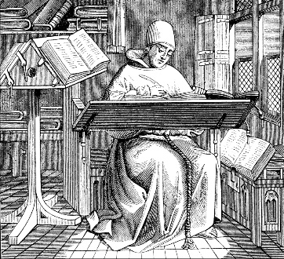
Some things I learned…
Respect for Biblical authority drove the scribal process – Rev. 22:18-19
Copying the Biblical text was really “expensive”
Many of the measures to publish and safeguard the Bible are embedded in the sacred text itself – Jer. 36:32; Deut. 31:24-26; 17:18; 2 Tim. 1:14; 2 Thess. 3:17; Eph. 6:21-22; 1 Thess. 5:23; Col. 4:16
This is a “hot” topic right now…

Slide 3
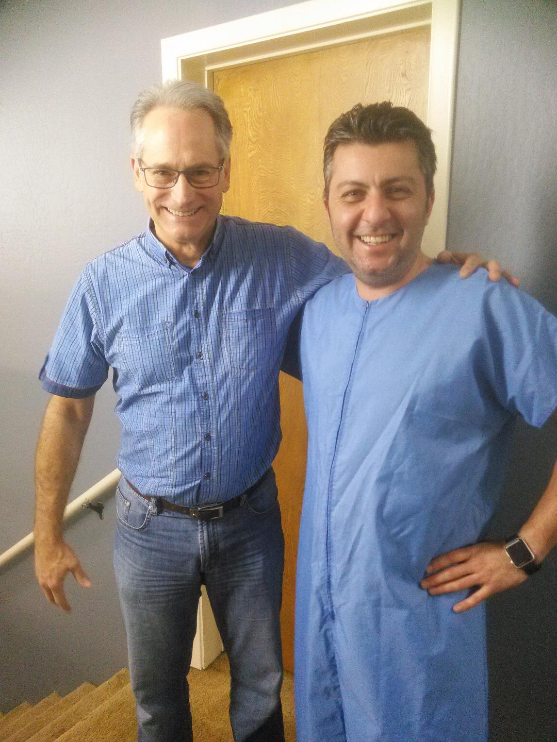

Slide 4
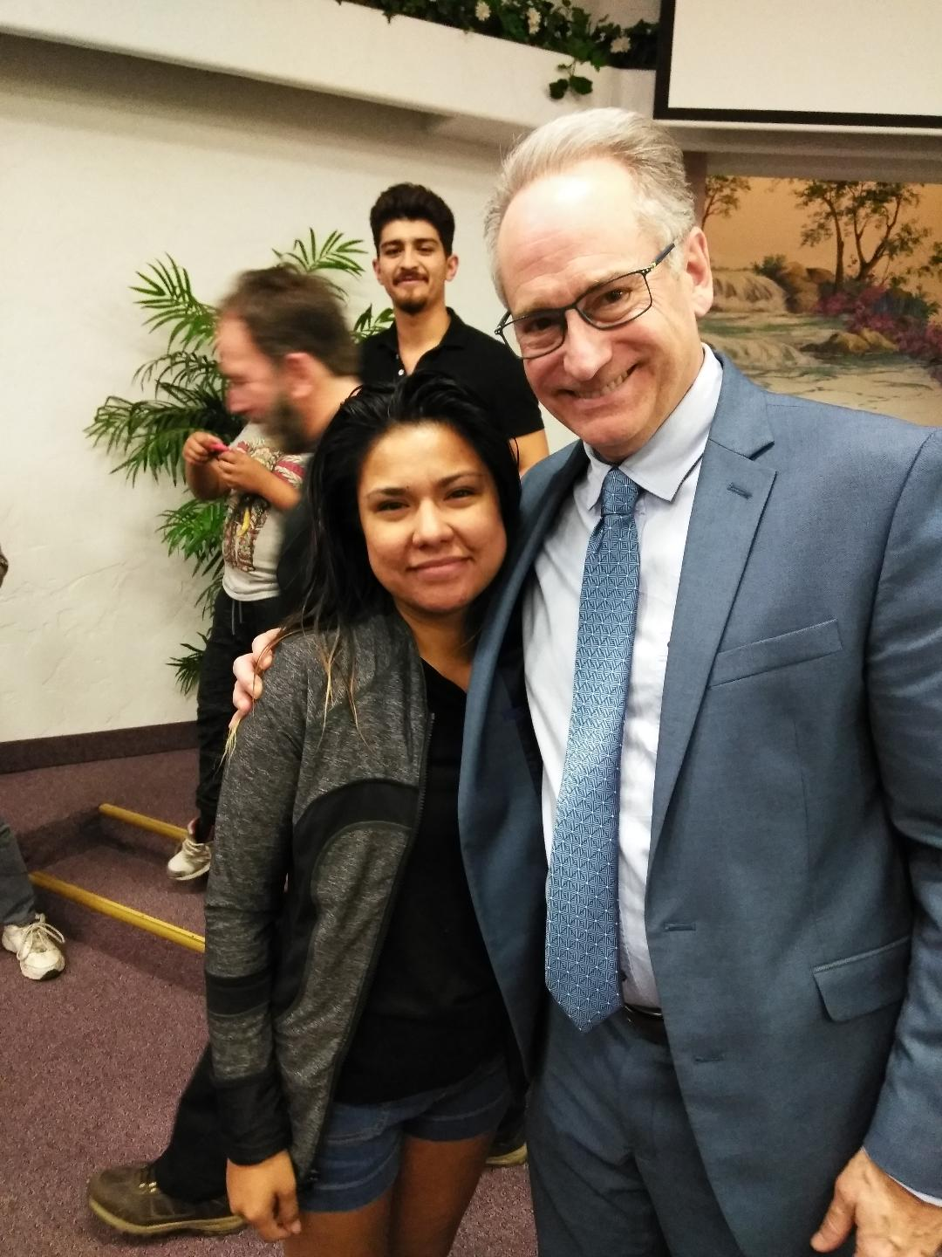

Slide 7
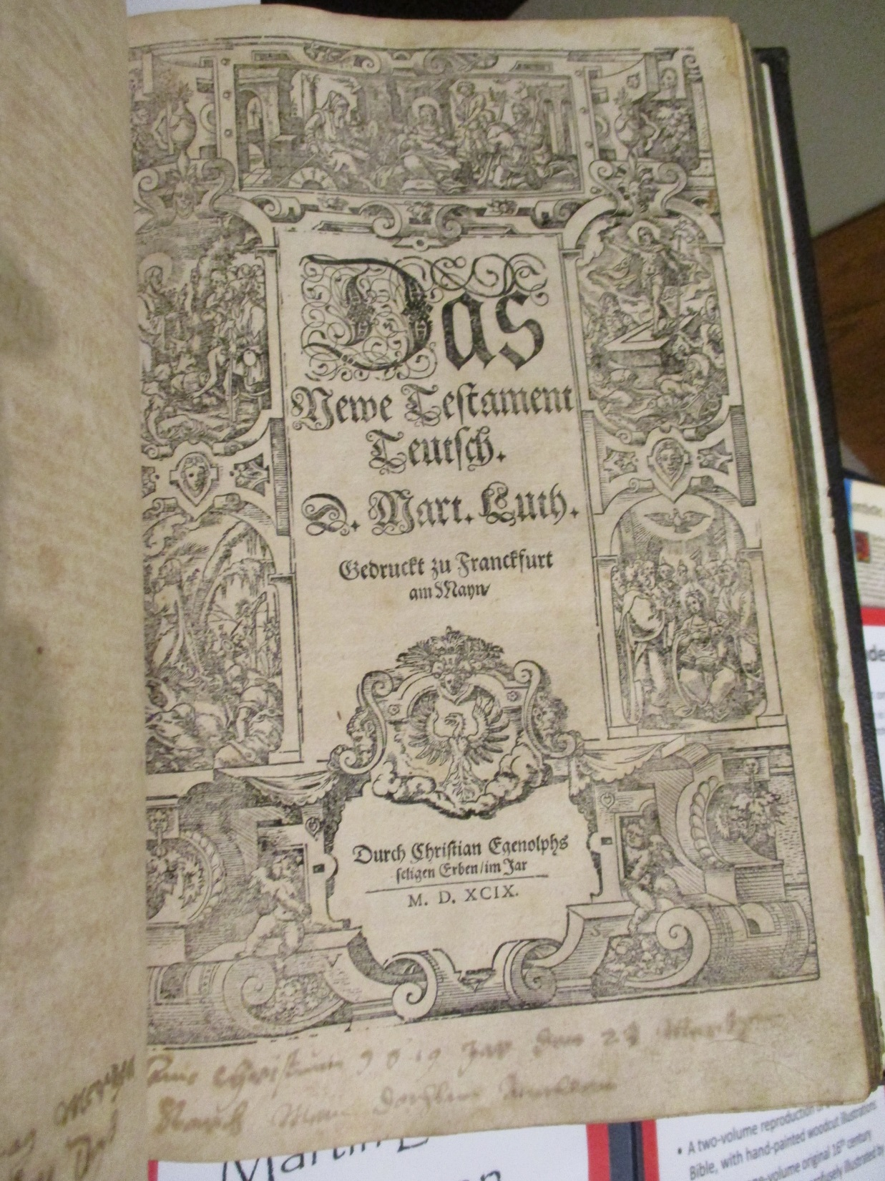

Slide 8
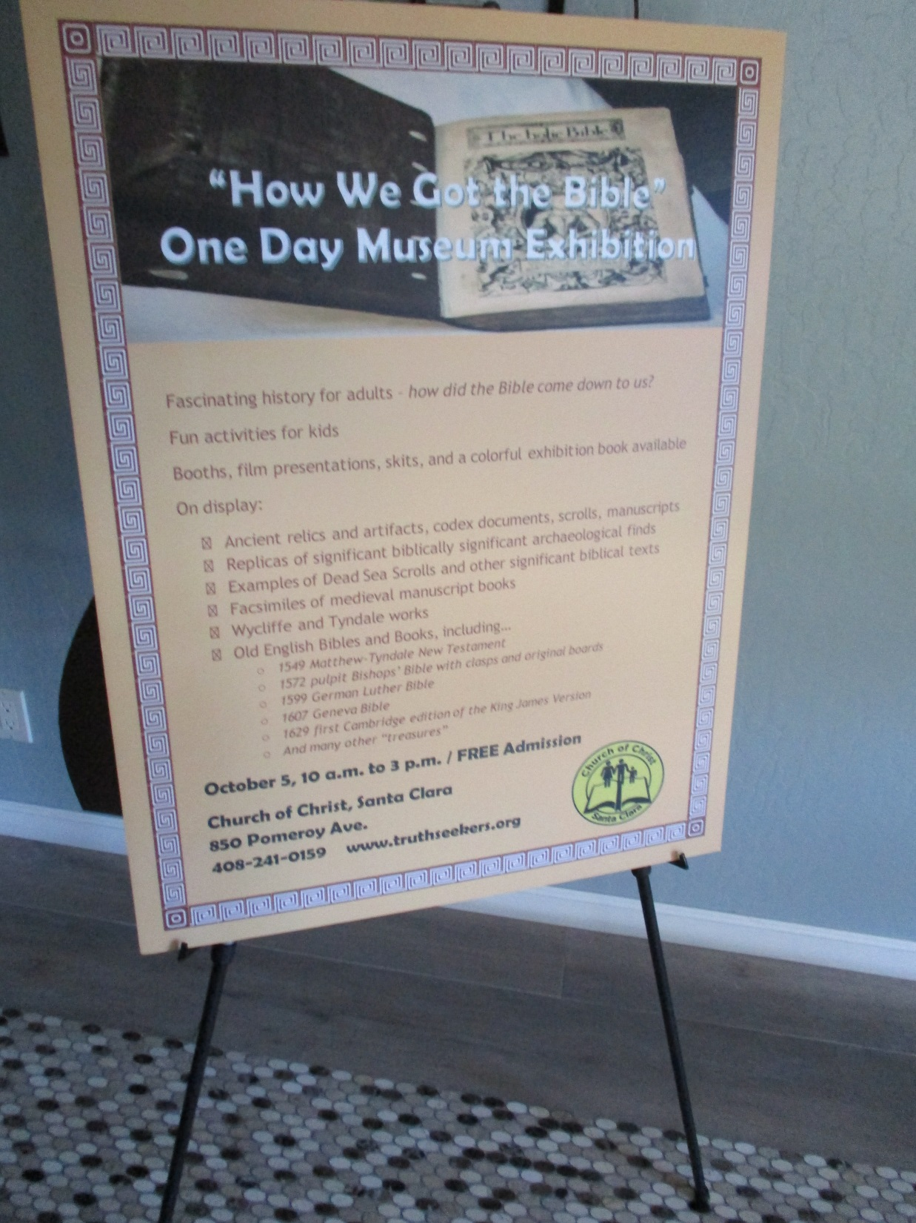

Slide 10
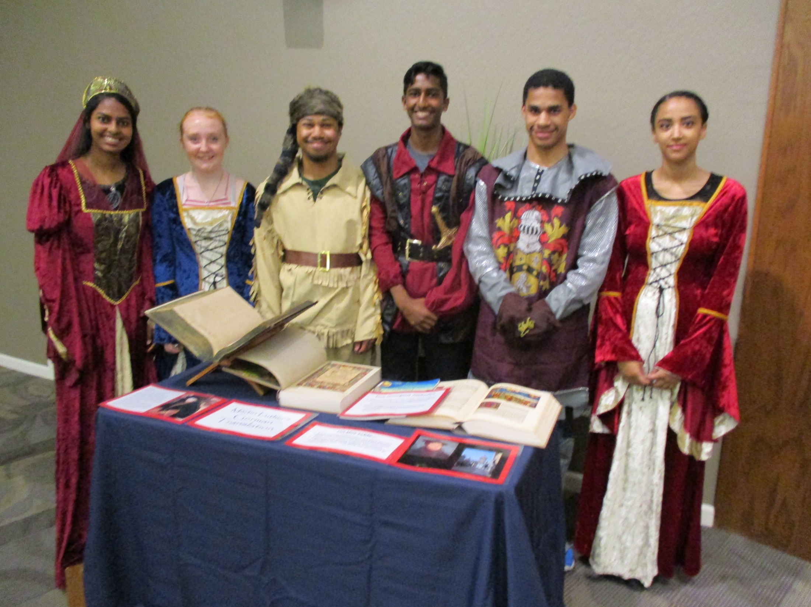

Slide 11
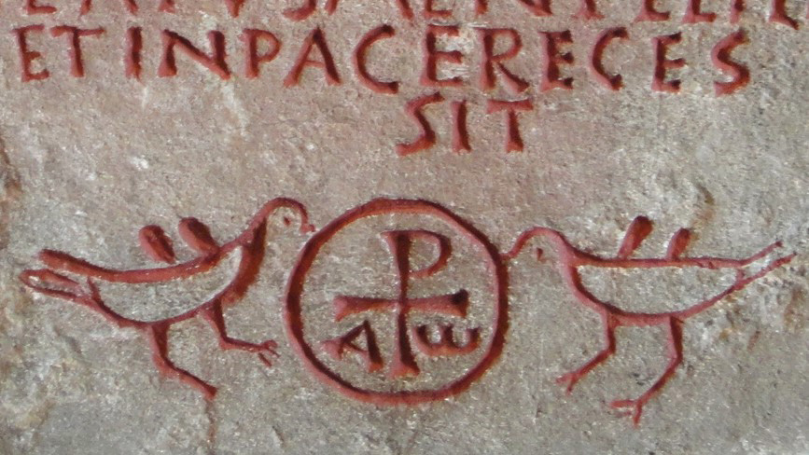

Slide 12
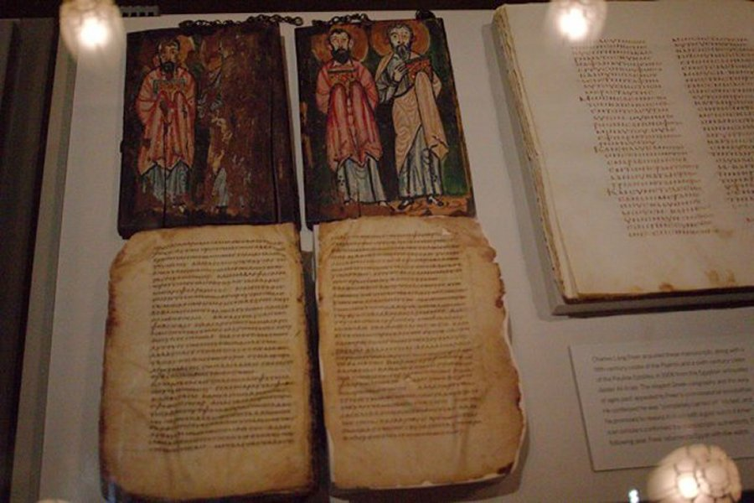

Slide 13
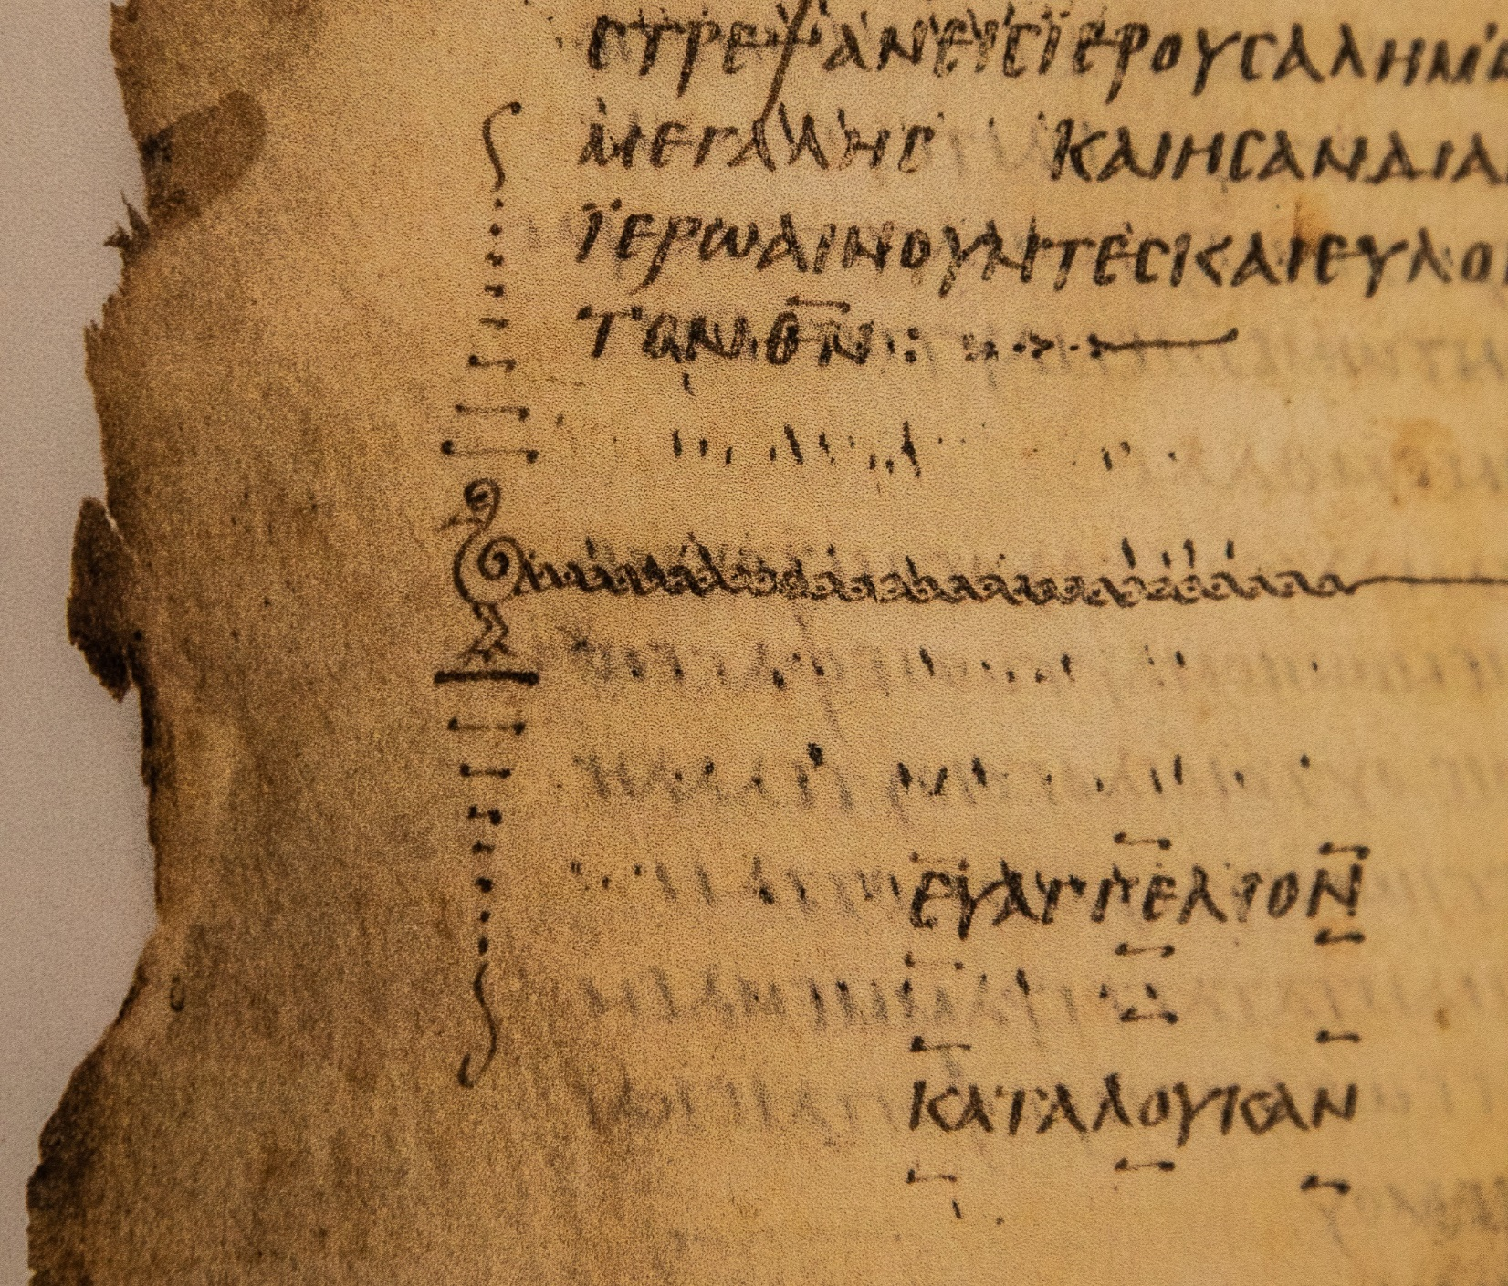

Slide 15
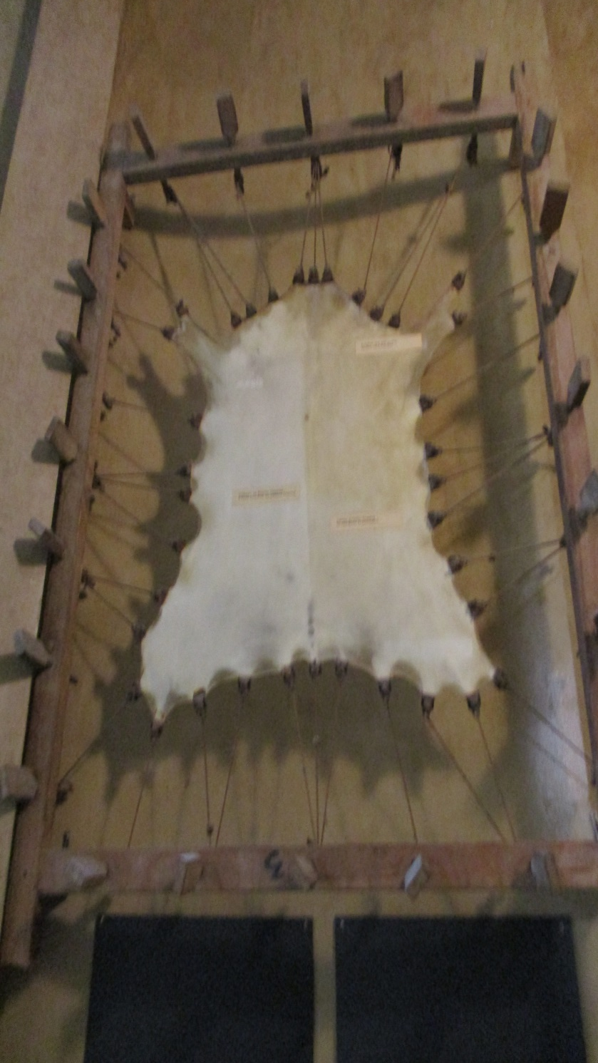

Slide 16
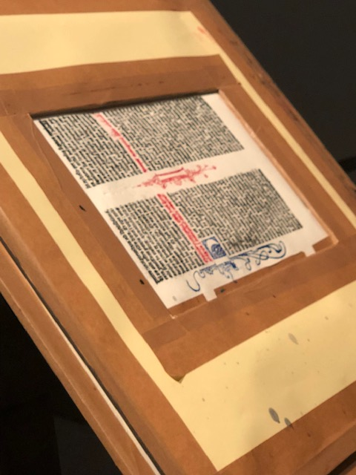
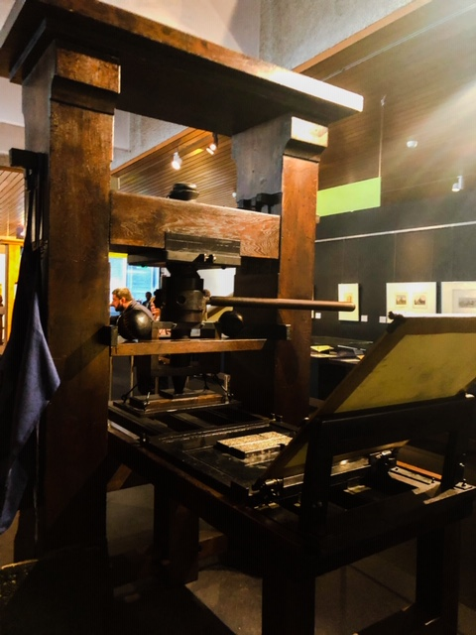
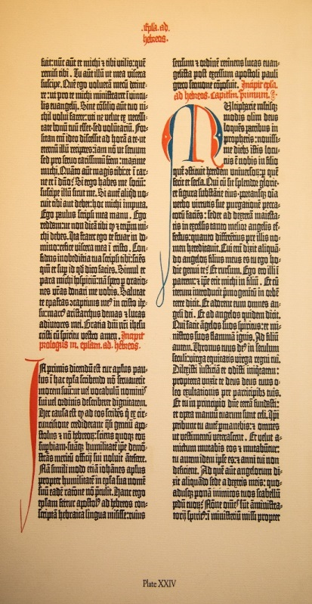
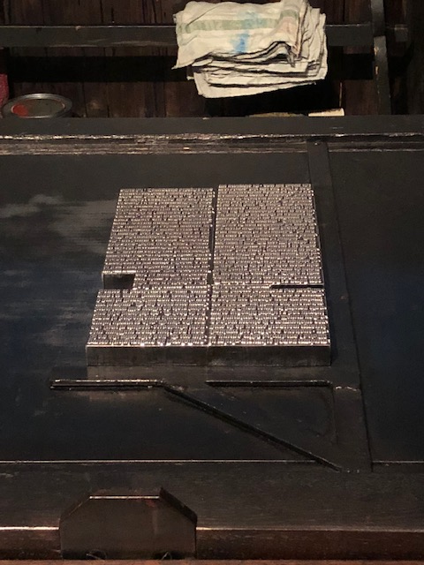

Slide 17
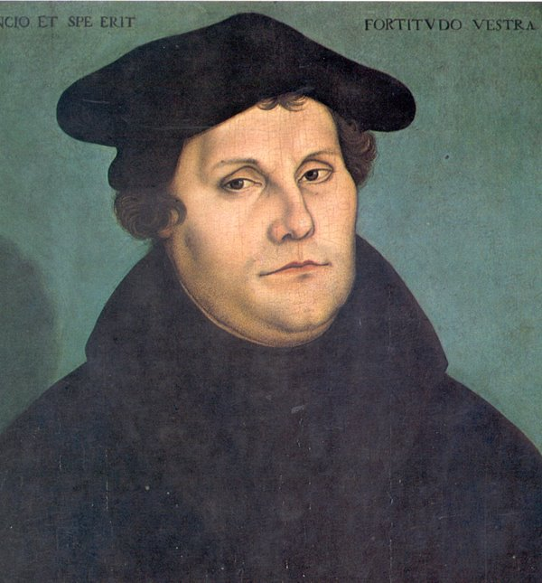

Slide 18
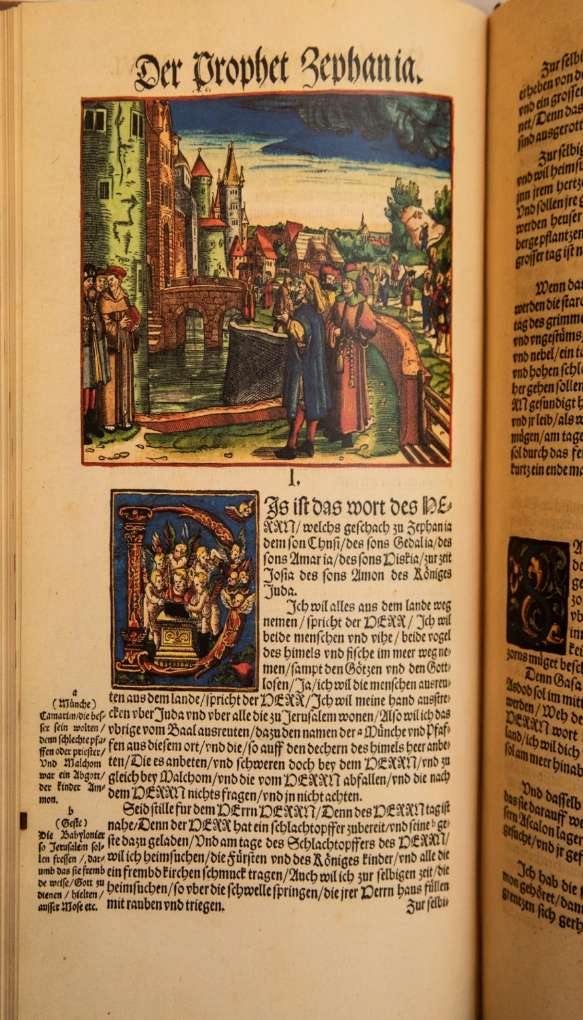

Slide 19
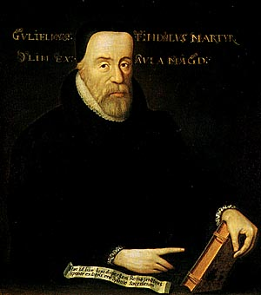

Slide 20
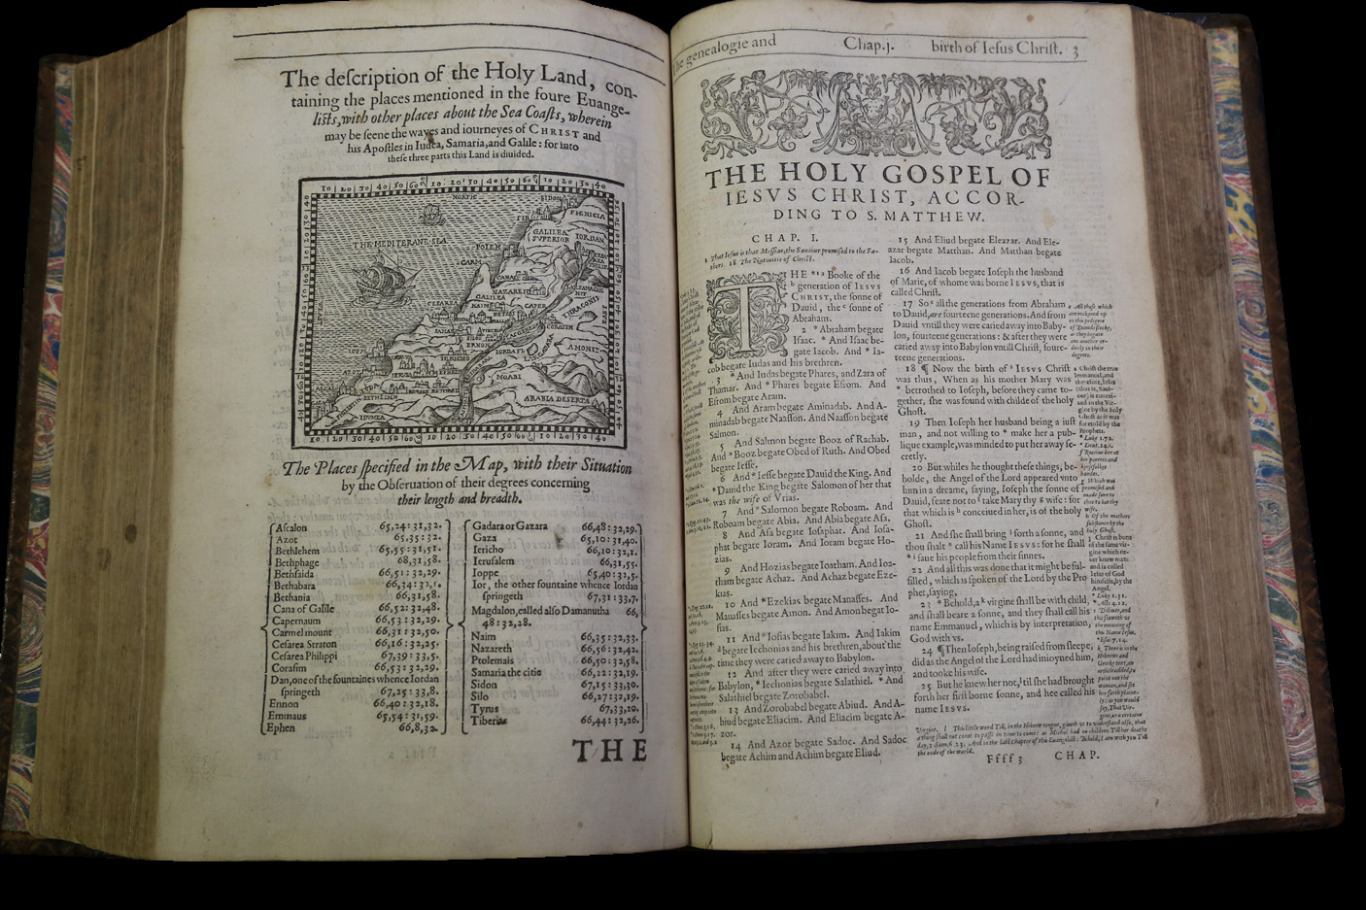

Slide 21
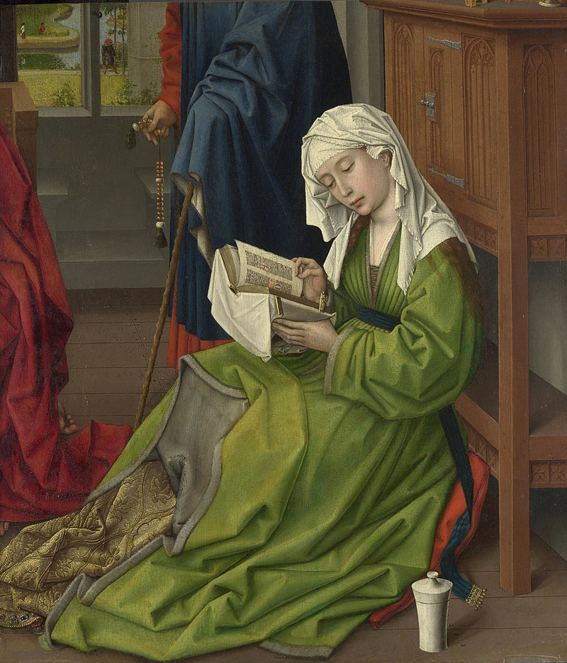

Slide 22
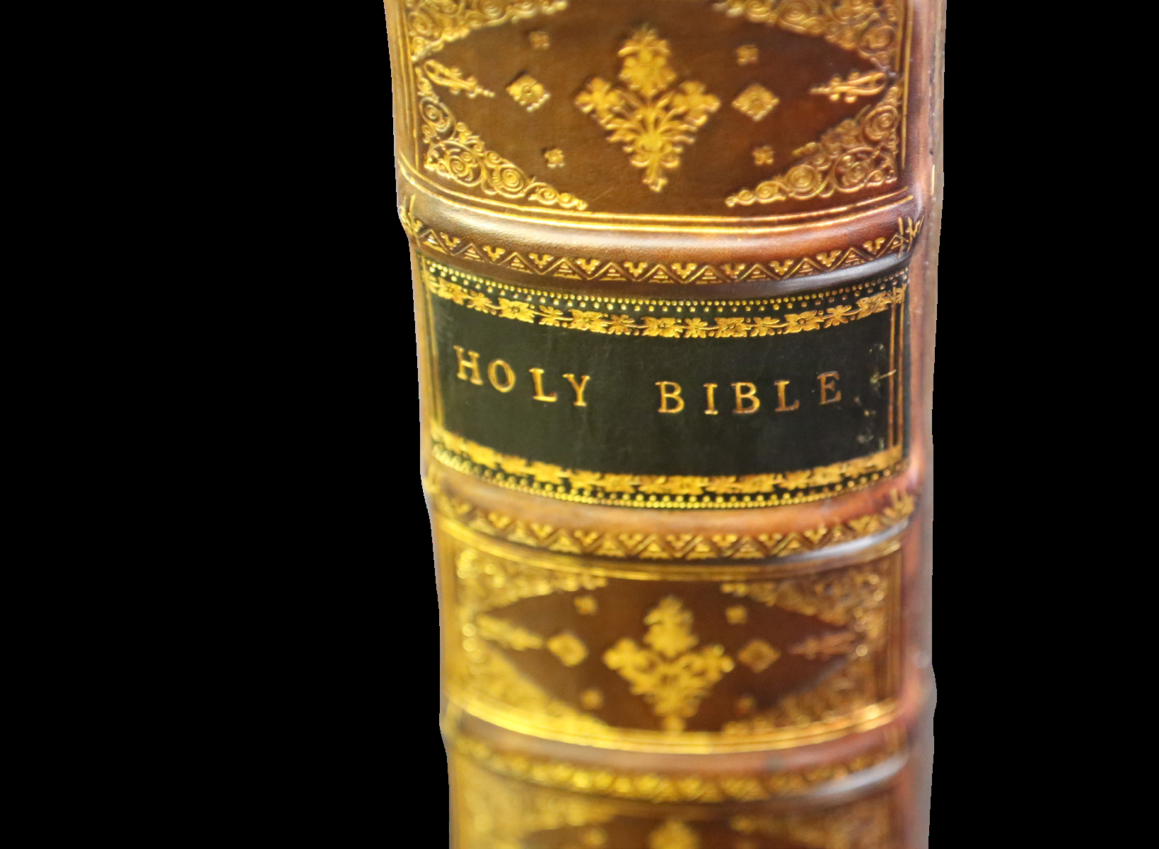

Slide 23
Competing Narratives
Alternative theorists must frame a narrative to fit their belief and agenda
When proponents are less than honest, evidence is manipulated, attacked, or ignored

Slide 24
Dan Brown’s character, Sir Leigh Teabing:
“The Bible is a product of man, my dear. Not of God. The Bible did not fall magically from the clouds. Man created it as a historical record of tumultuous times, and it has evolved through countless translations, additions, and revisions. History has never had a definitive version of the book...”

Slide 25
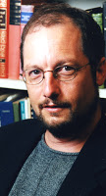
A Popular Skeptic
The Gospels had received all their material “fifth- or sixth- or nineteenth-hand…”
-- Bart Ehrman, Jesus, Interrupted p. 146-47

Slide 26
At the heart of the issue
Who is perpetuating a false narrative – the biblical writers or modern revisionists?

Slide 27
The Integrity of the Process
Acts 26:26-27 “But Paul said, ‘I am not out of my mind, most excellent Festus, but I am speaking true and rational words. For the king knows about these things, and to him I speak boldly. For I am persuaded that none of these things has escaped his notice, for this has not been done in a corner.”

Slide 28
Eyewitness Testimony
Acts 2:22, 32 “Men of Israel, hear these words: Jesus of Nazareth, a man attested to you by God with mighty works and wonders and signs that God did through him in your midst, as you yourselves know…
This Jesus God raised up, and of that we all are witnesses.”

Slide 29
Resistance Could be Intense
Acts 4:13-20
13 Now when they saw the boldness of Peter and John, and perceived that they were uneducated, common men, they were astonished. And they recognized that they had been with Jesus. 14 But seeing the man who was healed standing beside them, they had nothing to say in opposition. 15 But when they had commanded them to leave the council, they conferred with one another, 16 saying, “What shall we do with these men? For that a notable sign has been performed through them is evident to all the inhabitants of Jerusalem, and we cannot deny it…

Slide 30
Resistance Could be Intense
Acts 4:13-20 (continued)
17 But in order that it may spread no further among the people, let us warn them to speak no more to anyone in this name.” 18 So they called them and charged them not to speak or teach at all in the name of Jesus. 19 But Peter and John answered them, “Whether it is right in the sight of God to listen to you rather than to God, you must judge, 20 for we cannot but speak of what we have seen and heard.”

Slide 31
Testing Genuine vs. Counterfeit Prophets
Joseph vs. Pharaoh’s magicians – Gen. 41
Moses vs. Pharaoh’s magicians – Exod. 7:8-12; 8:19
Elijah vs. 450 prophets of Baal – 1 Kings 18
Jeremiah vs. Hananiah – Jer. 28
Daniel vs. Babylonian wise men – Dan. 2
Paul vs. Elymas – Acts 13

Slide 32
Cross Verification
Deuteronomy 17:18 – “And when he sits on the throne of his kingdom, he shall write for himself in a book a copy of this law, approved by the Levitical priests.”
1 Cor. 12:10 – “the ability to distinguish between spirits”

Slide 33
Cross Verification
1 Jn. 4:1– “Beloved, do not believe every spirit, but test the spirits to see whether they are from God, for many false prophets have gone out into the world.”

Slide 34
From the very beginning…
Peter vouches for Paul’s epistles as “scripture” – 2 Pet. 3:15-16
Paul cites a passage cited in Luke 10:7 side by side with Deut. 25:4 as “scripture” – 1 Tim. 5:18
Paul mentions collaboration with “James and Cephas and John” – Gal. 2:9
At least three of Paul’s travel companions were members of the early Jerusalem church – Barnabas, John Mark, and Silas

Slide 35
The core message did not change
Paul “received from the Lord” the same Lord’s Supper message as found in the synoptic Gospels – 1 Cor. 11:23-25
He makes a distinction what the Lord had taught on divorce and remarriage and what he adds as an apostle – 1 Cor. 7:10-11, 12-16
The death, burial, resurrection, and appearances of Christ were “received” and “delivered” – 1 Cor. 15:3-8

Slide 36
Early manuscript discoveries…
Shorten the time lag between the actual events and the Gospels as we now have them
P32 (Titus), P52 (John), and P104 (Matthew) were all likely written at the beginning of the 2nd century (and possibly at the end of the first century)
2nd century Christians such as Papias and Polycarp knew the apostle John in Ephesus at the end of the 1st century
Eyewitnesses and others who knew eyewitnesses did not suddenly disappear but existed in abundance throughout the 1st century… and into the 2nd
The New Testament documents were not produced in a vacuum

Slide 37
One Book
About 40 authors… 3 continents… over 1500 years… one message!
“One faith” – Eph. 4:4-6

Slide 38
Down through the ages
Checks and balances in publishing the Bible
Honesty… sealed in blood
Integrity in making copies
The decentralization of the manuscripts is a guarantee that we can reconstruct the sacred text with absolute certainty

Slide 39
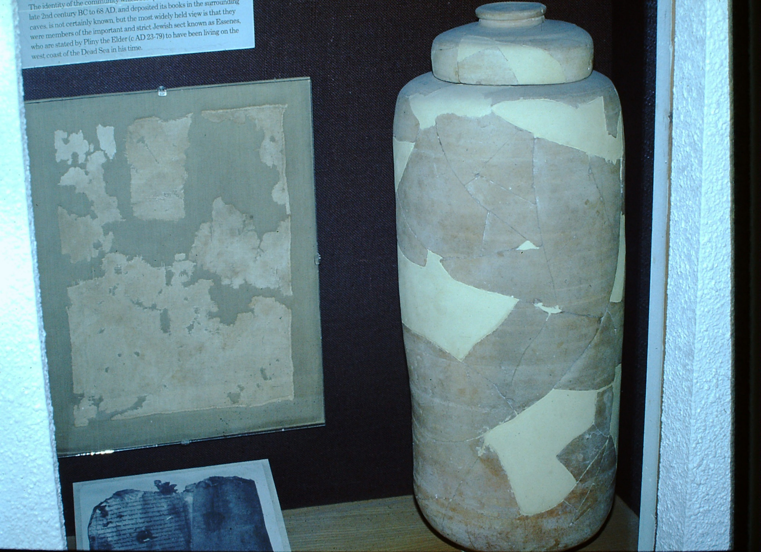

Slide 40
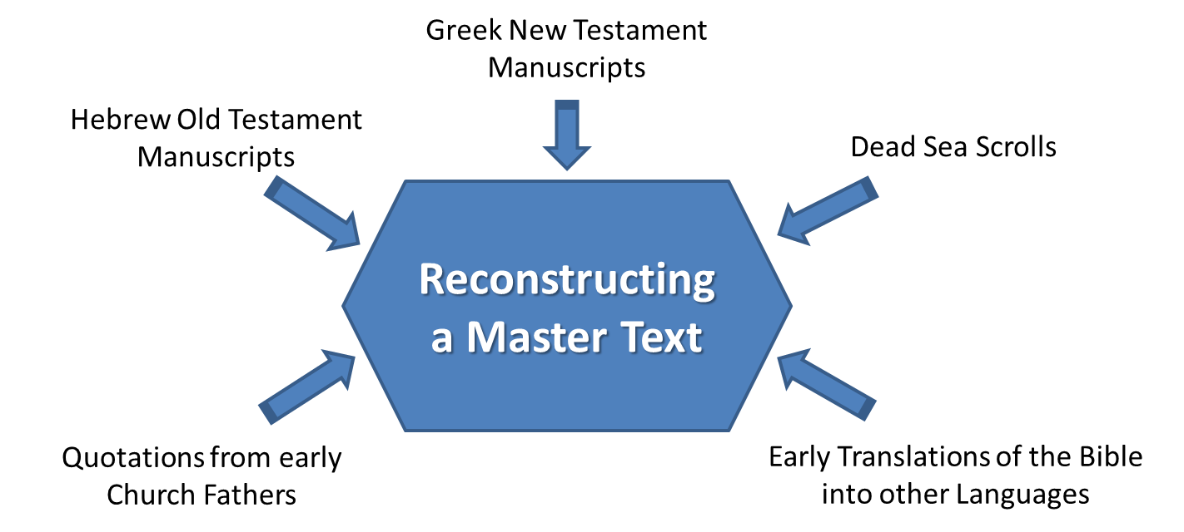

Slide 41
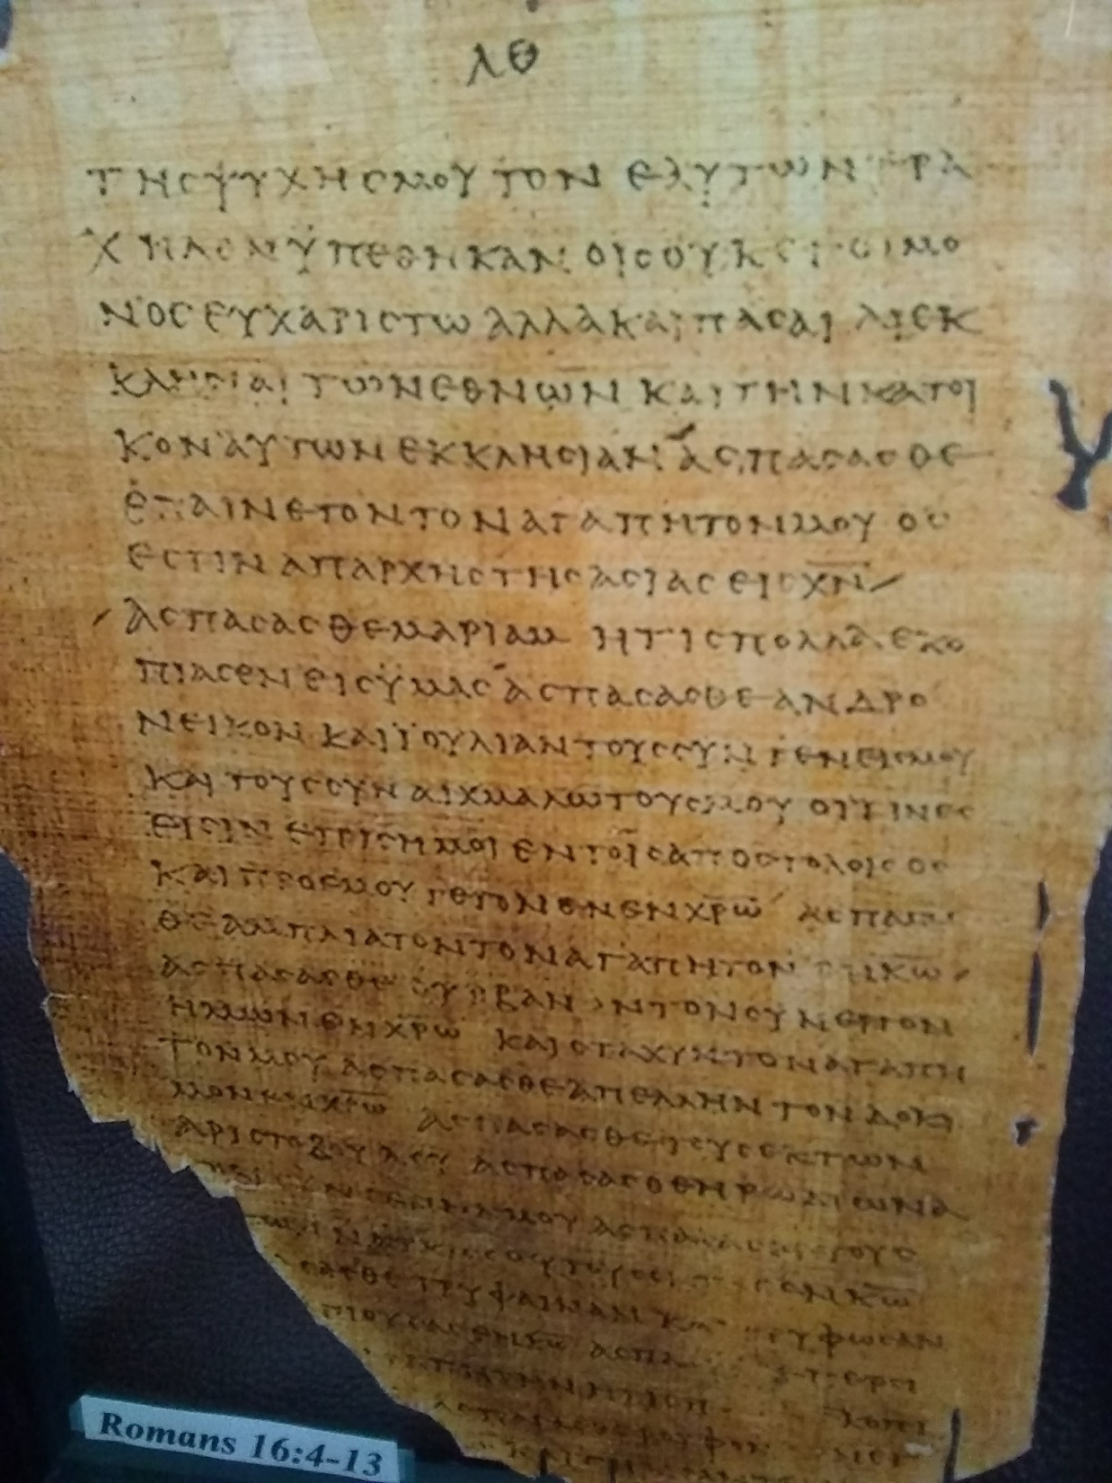

Slide 42
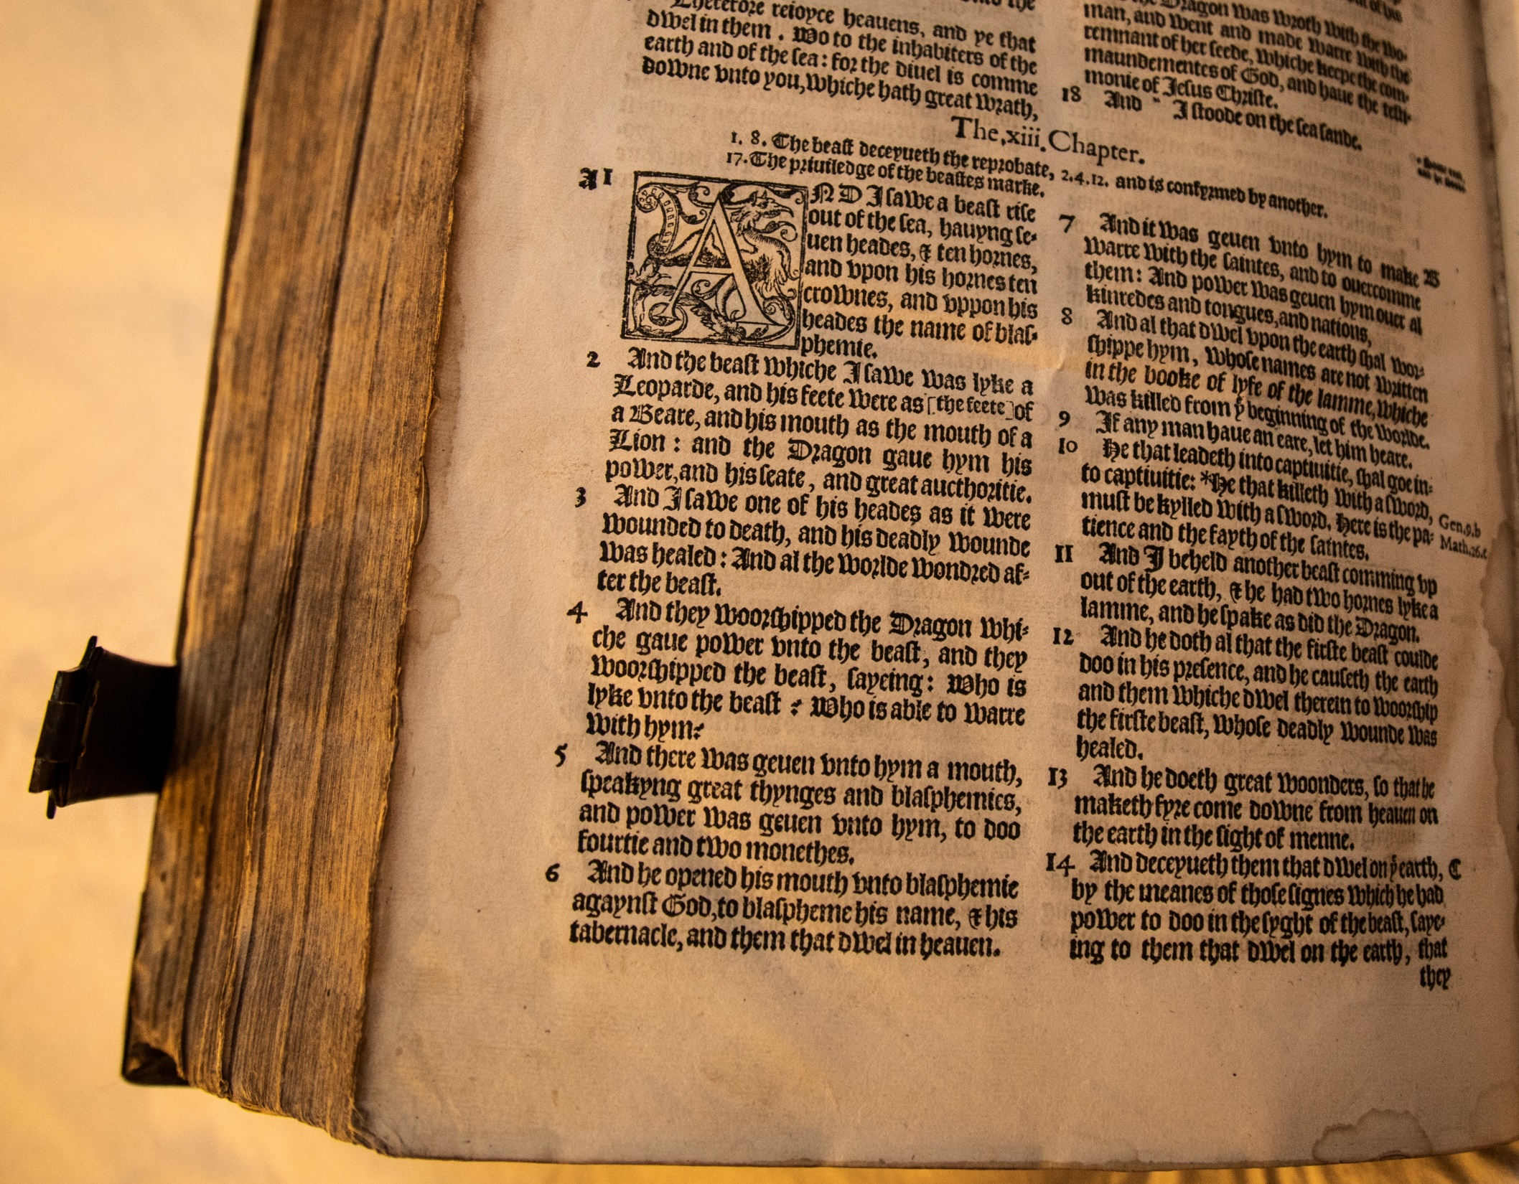

Slide 43
One Book… many translations

Slide 44
The Undisputed Best Seller
According to Guinness World Records, as of 1995, the Bible is the best-selling book of all time, with an estimated 5 billion copies sold and distributed
Although it’s excluded from the Bestseller Lists, it’s the best seller this year… and the year before that… and the year before that…

Slide 45
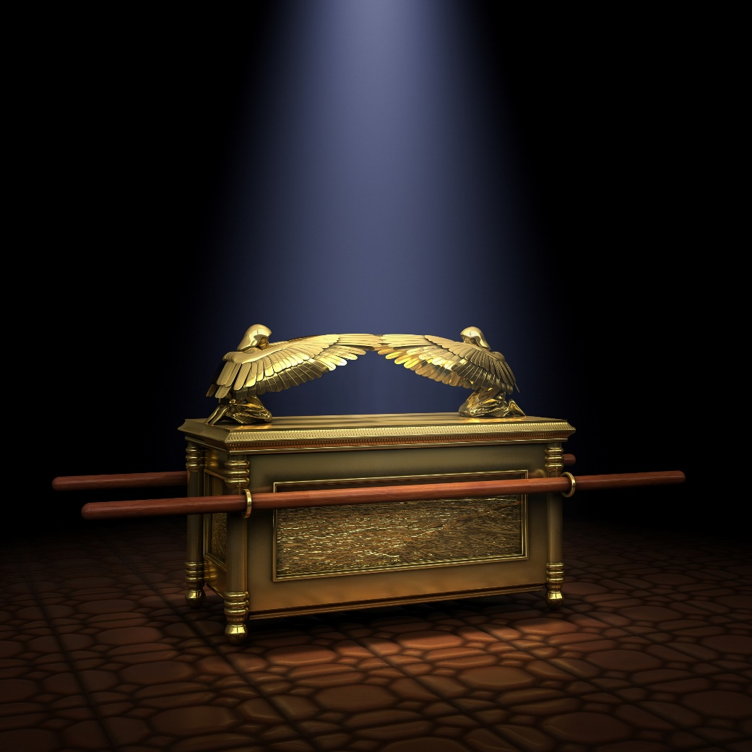
Deposit for Safe-Keeping
Deut. 31:24-26
“24 When Moses had finished writing the words of this law in a book to the very end, 25 Moses commanded the Levites who carried the ark of the covenant of the Lord, 26 ‘Take this Book of the Law and put it by the side of the ark of the covenant of the Lord your God, that it may be there for a witness against you.’”

Slide 46
A Better Repository!
Better than a perishable treasure-chest
2 Cor. 3:3 – “And you show that you are a letter from Christ delivered by us, written not with ink but with the Spirit of the living God, not on tablets of stone but on tablets of human hearts.”
Jer. 31:33 – “I will put my law within them, and I will write it on their hearts.”

Slide 47
Deposit for Safe-Keeping
Psalm 119:11 – “I have stored up your word in my heart, that I might not sin against you.”
2 Cor. 4:7 – “But we have this treasure in jars of clay, to show that the surpassing power belongs to God and not to us.”

Slide 48
A single message… aimed at your heart
The “gospel” (= good news) of Jesus Christ
Lost in sin
Saved by God’s grace
Accessed by obedient faith
Opportunity for eternal life with God!
Moved by love…

Slide 49
God wants a covenant relationship with YOU!
John 3:16 – “For God so loved the world that he gave his only Son, that whoever believes in him should not perish but have eternal life.”

Slide 50
Salvation is “in Christ”
Galatians 3:26-27– “For in Christ Jesus you are all sons of God, through faith. For as many of you as were baptized into Christ have put on Christ.”

